Slide 1
BENIGN OR MALIGNANT? BRAIN TUMOUR CLASSIFICATION WITH KNN, LOGISTIC REGRESSION AND NEURAL NETWORK
IT1244 Team 14
Chua Yeong Hui, Lee Yu Xuan Olivia, Tan Kia Leng, Wong Xin Ying

Slide 2
Introduction
Data Importation and Cleaning
Primary Preprocessing: load, process, train-test split, augment, normalise
Improved Preprocessing
Machine Learning Algorithms
kNN
Logistic Regression
Neural Network
Conclusion

Slide 3
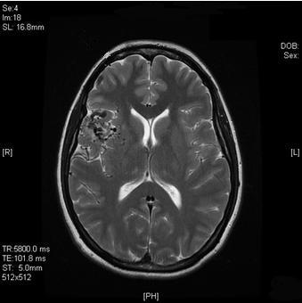
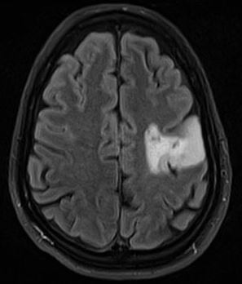
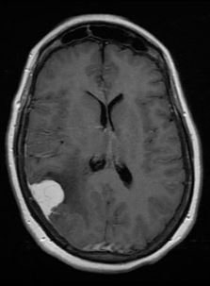
Benign or malignant?
Notes:
Note: can ask audience to guess - benign, malignant, malignant

Slide 4



An AI solution…
CLASSIFICATION!
kNN
Logistic Regression
Neural Network
Notes:
kNN - similarity metric, non-linear relationships with a distance metric
LR - linear relationships between iv (no collinearity)
neural network- more complex relationships

Slide 5
Introduction
Data Importation and Cleaning
Primary Preprocessing: load, process, train-test split, augment, normalise
Improved Preprocessing
Machine Learning Algorithms
kNN
Logistic Regression
Neural Network
Conclusion

Slide 6
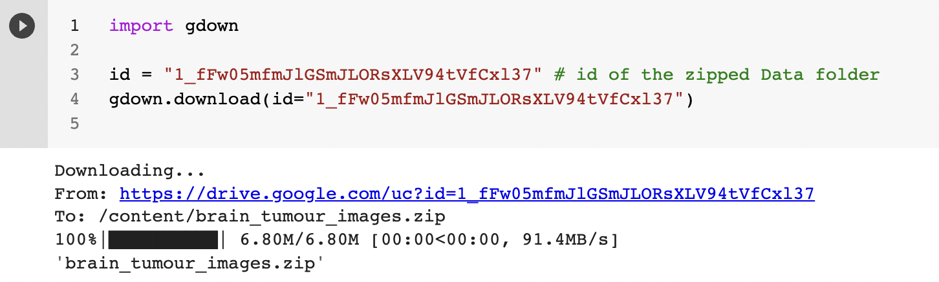
Step 1: Load data
Zipfolder is stored in a Google Drive
Dataset loaded programmatically

Slide 7
Step 2: Getting datasets
Process image to numpy array
Packages used:
os - get working directory
zipfile - unzip the zipfile
PIL - load image
numpy - store and reshape the images
Functions:
get_X() → numpy array with shape (N, 244*244)
create_y(n_benign,n_malignant) → numpy array with shape (N)
0 for benign, 1 for malignant

Slide 8
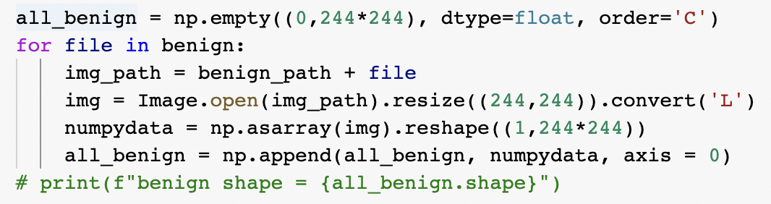
Step 2: Getting datasets
A snippet of the code for get_X():
Generic flow:
process benign images, store into one array
repeat for malignant images
then concatenate both arrays together

Slide 9
Step 3: Train-test split
train_test_split()function from sklearn
randomness needed in splitting
original dataset is sorted with benign first then malignant
test size of 25%
test data has more malignant than benign data

Slide 10
Step 4: Data Augmentation
Done by randomly flipping and rotating images using Tensorflow
Increases dataset and balances out no of benign and malignant images
data_aug(X,Y,rat) → (aug_X,aug_Y)
Input:
trainX (N,244*244) and trainY (N)
ratio - multiple to apply to class we have most of
e.g. # input: 200 benign, 100 malignant, ratio=2
# output desired: 400 each
# to generate: 200 benign and 300 malignant
mult = # to generate/ # input: 1x for benign, 3x for malignant
Output:
aug_X and aug_Y

Slide 11
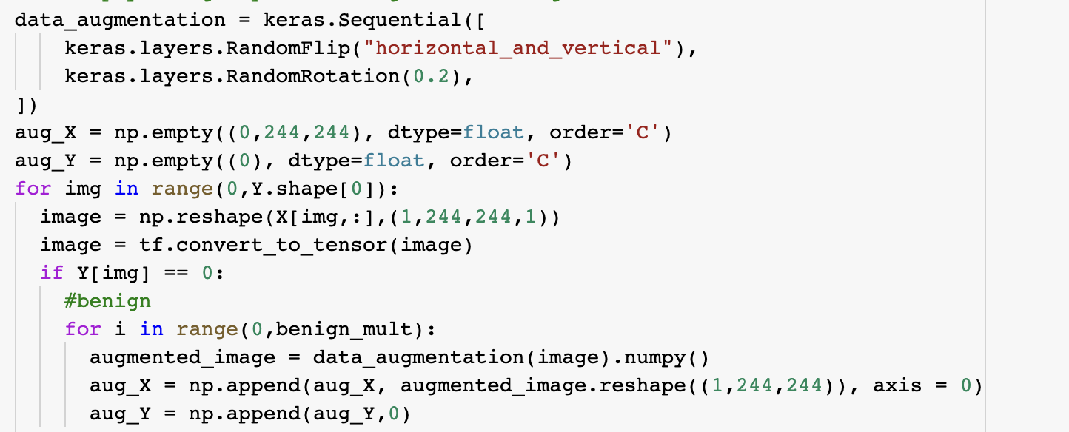
Step 4: Data Augmentation
Code snippet:

Slide 12
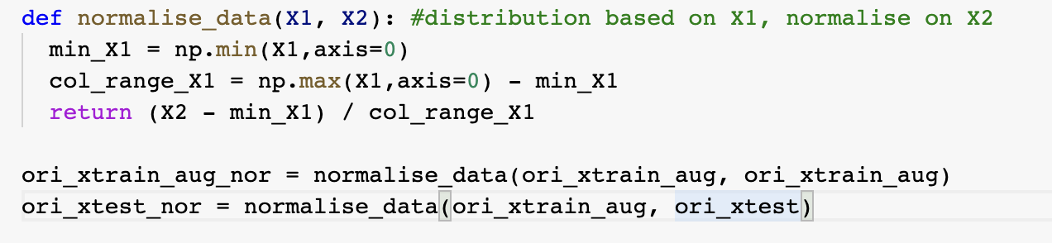
Step 5: Normalisation
Normalise both Xtrain and Xtest with distribution of Xtrain

Slide 13
Introduction
Data Importation and Cleaning
Primary Preprocessing: load, process, train-test split, augment, normalise
Improved Preprocessing
Machine Learning Algorithms
kNN
Logistic Regression
Neural Network
Conclusion

Slide 14
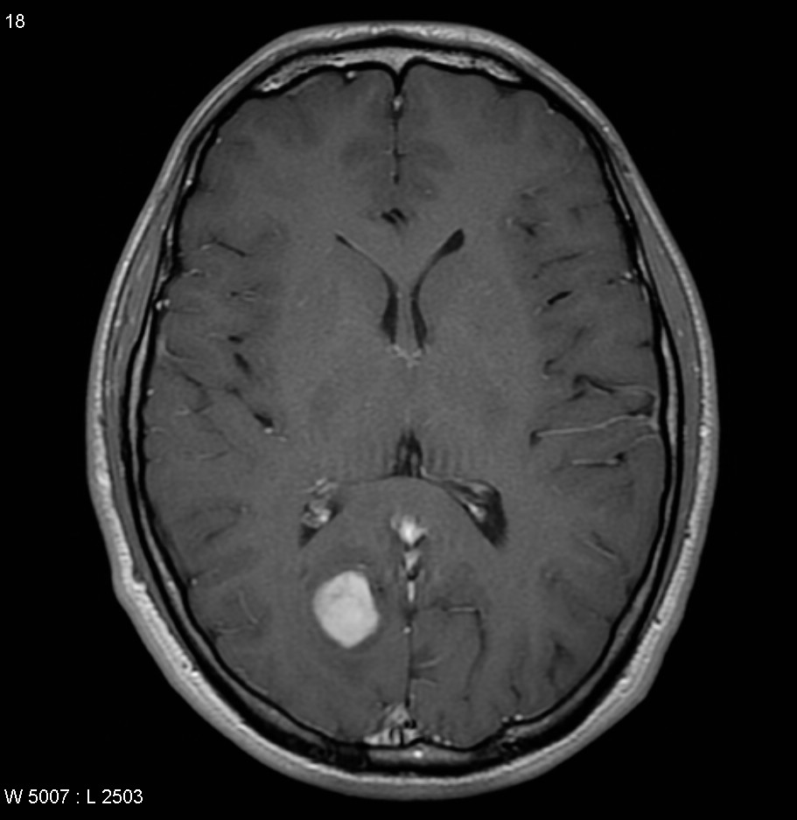
Objective
Labels and empty spaces will be cropped out
Notes:
The objective of improved data processing is to remove all unwanted objects from images, such as annotations (eg. Malignant Image 6) by cropping. By delineating the brain in the improved dataset, it will be easier for our models to carry out classification.

Slide 15
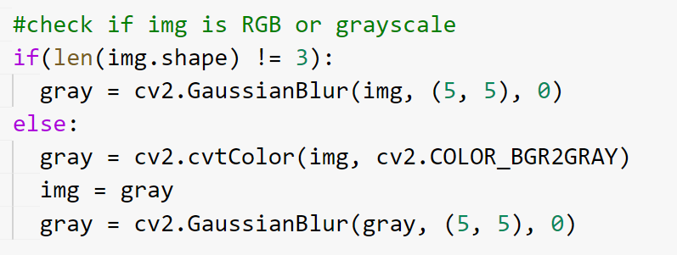
Step 1: Conversion to Grayscale
All images to be converted to grayscale
Notes:
All images must be converted to grayscale. The “if statement” checks for grayscale images. If the image does not have 3 channels which represents an RGB image, gaussian blurring will be applied to remove gaussian noise from the image straightaway. Else, the RGB image will be converted to grayscale first before applying gaussian blurring.

Slide 16
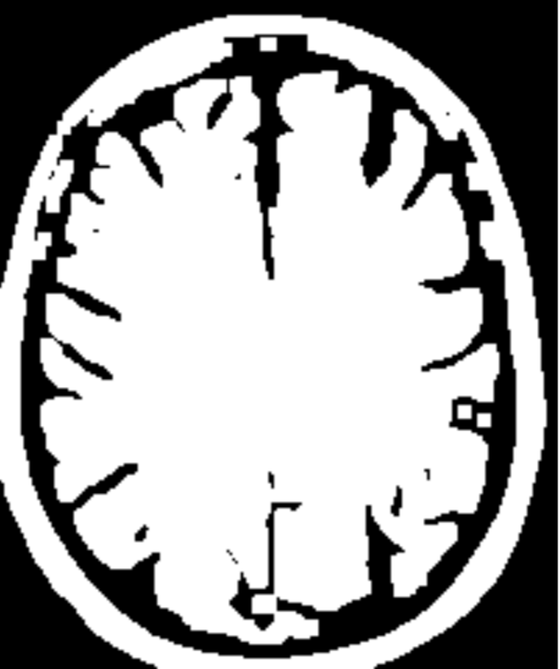
Step 2: Binary Thresholding
Segments the outline of the brain in the images to white to facilitate contour detection
Notes:
The next step binary thresholding. It segments the outline of the brain to white to facilitate contour detection.

Slide 17
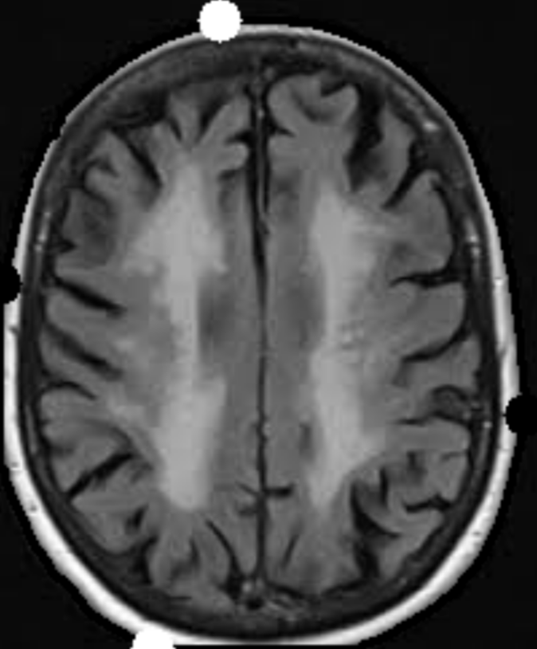
Step 3: Finding contours of brain
Contours found from thresholded images
Extreme points along the contours (top, bottom, left, right) were found
Contours were overlaid on the images for cropping

Slide 18
Step 4: Cropping
Images were cropped based on the contours
Images resized to 244 x 244
Notes:
After cropping the images, we then did train-test split, data augmentation and normalisation as explained by chloe earlier.
We will only be showing our results for the improved dataset with logistic regression as we only had better results with logistic regression.

Slide 19
Introduction
Data Importation and Cleaning
Primary Preprocessing: load, process, train-test split, augment, normalise
Improved Preprocessing
Machine Learning Algorithms
kNN
Logistic Regression
Neural Network
Conclusion

Slide 20
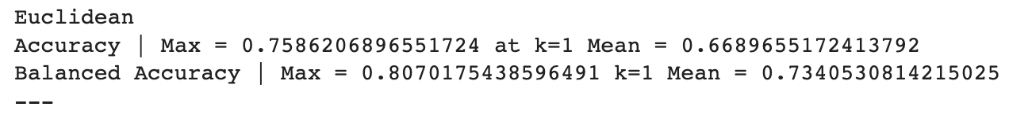
kNN implementation
sklearn’s KNeighborsClassifier used
different k-values were tested to programmatically find max accuracy and k-value when it occurs
problem: max accuracy when k=1 (overfitting, high variance)
likely cause: data is high dimensional but euclidean similarity measure is used
solution: change similarity measure to cosine

Slide 21
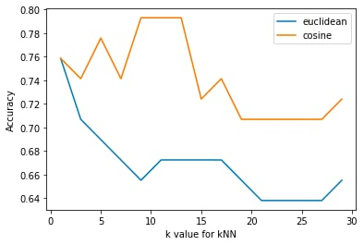
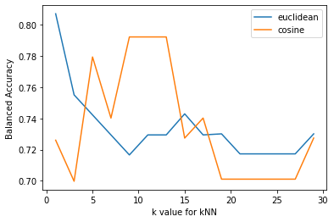
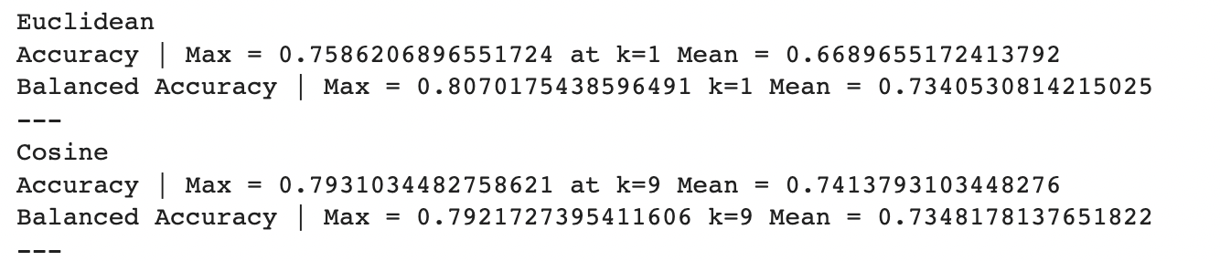
kNN results
Notes:
Note: test data has 2x more malignant than benign
so balanced accuracy focuses on prediction of benign data (reduce benign marked as malignant) while accuracy focuses on prediction of malignant data (reduce malignant marked as benign) - can be argued that accuracy is more impt than balanced accuracy in this case.
More malignant in dataset - high false negative rate for euclidean
diff runs lead to diff results in terms of whether max euclidean or max cosine is better, but the trend that euclidean has k=1 is there
high variance if peak is at k=1

Slide 22
Introduction
Data Importation and Cleaning
Primary Preprocessing: load, process, train-test split, augment, normalise
Improved Preprocessing
Machine Learning Algorithms
kNN
Logistic Regression
Neural Network
Conclusion

Slide 23
Logistic Regression implementation
sklearn’s LogisticRegression classifier used
Models generated:
model_ori
model_imp
Fine tuned parameters:
Increasing maximum number of iterations
Included class_weight = ‘balanced’

Slide 24
Logistic Regression evaluation methods
Confusion matrix
Balanced accuracy
accounts for imbalance datasets
F1 score
crucial for monitoring False Negatives (FN)
Precision
Recall
important when FN cost is high
Notes:
Run through the methods
speak about the importance of monitoring FN
give an example on that

Slide 25
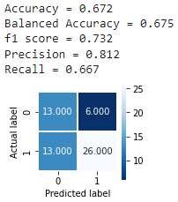
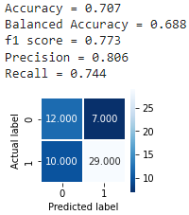
Logistic Regression Results
For model_ori
For model_imp
Notes:
Present results (highlight the fall in FN)
Interpret the difference in the results

Slide 26
Introduction
Data Importation and Cleaning
Primary Preprocessing: load, process, train-test split, augment, normalise
Improved Preprocessing
Machine Learning Algorithms
kNN
Logistic Regression
Neural Network
Conclusion

Slide 27
Neural Network Implementation
Input: unnormalised data
Convolution layer: Conv2D (relu activation)
Inputs with 2 spatial dimensions
BatchNormalisation
Ensures mean and standard deviation of layer inputs remain the same
Pooling layer: MaxPooling2D
Reduces computational load, memory usage and number of paras for 2D input
Dense layer (sigmoid activation on the final layer)
Dataset has binary variables (tumor classified as malignant or benign)
Optimizer: Stochastic Gradient Descent (SGD)

Slide 28
Problem encountered & Solutions
Overfitting: Training loss decreasing but validation loss increasing
Data augmentation
Spatial Dropout
Drops a predetermined number of feature maps from the convolution layer
Dropout
Randomly drops nodes between dense layers

Slide 29
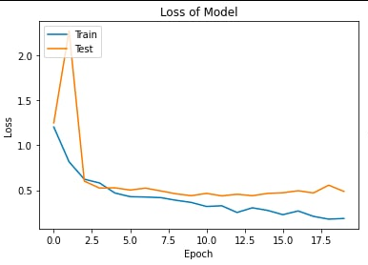
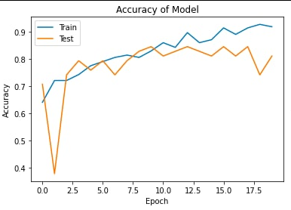
Evaluation metrics and results
Loss: Binary cross entropy
For binary variables
Accuracy

Slide 30
Introduction
Data Importation and Cleaning
Primary Preprocessing: load, process, train-test split, augment, normalise
Improved Preprocessing
Machine Learning Algorithms
kNN
Logistic Regression
Neural Network
Conclusion

Slide 31
Evaluating ML
NN is the most effective model for brain tumour image classification (with complex dataset)
KNN comes second when there are fewer datasets
Notes:
From our results, we conclude that neural network with the primary preprocessing data is the most effective model.

Slide 32
Evaluating ML with improved dataset
KNN
Obtained bad results → k=1
Logistic Regression
Obtained better results with improved
Neural Network
Input of NN should be unnormalised data, but the improved dataset is “normalised” through cropping
Notes:
Here is our evaluation of the models with the improved dataset
More analysis and work has to be done to understand how to utilise our improved dataset with our 3 models.

Slide 33
Thank you!

